Slide 1

Overview
Preliminary research
  The Context and Why it is important
  Deconstructing the Task
Framework and Dataset
Analysis
  Correlation Analysis
  Spatial Analysis
Results and Discussion
  Key Findings
  How to assess the results
  Potential Future Consideration

Slide 2

Preliminary research
The Context
Schools are often at the heart of community development. Ensuring that schools are well-located and adequately resourced allows the government to foster community cohesion and support broader social and economic goals.
Why it is important to our government? (Benefits)
Provides a reference for decision-making in infrastructure development to better serve the public.
Assists in urban and community development planning.
Addresses issues of educational equity.

Slide 3

Preliminary research
School Demographics
Student’s Basic Info
Language: English, French
Type: Catholic, Public, Private…
Academic Performance: EQAO Pass Rate
Immigration Factor
…
Geographic Distribution
School Board Funding
Reputation or Ranking
School Facilities and spaces
Accessibility - Bus routes
Urban Data Research
Student Enrolment¹
Enrollment Numbers and Enrollment Time
Level: Kindergarten, Elementary, Secondary
Grade Distribution
…
Family Income
Teacher-Student Ratio
College or University Source
Fewer schools but
higher student density
Areas for new school construction
Citizen Population Census
Land Use
Economic Factors - Career Opportunities
City/Town Development Plans
New Immigrant Population
…
Demographics Data
Deconstructing the Topic and Establishing Tasks
¹ Reference: “2023 Ontario School Boards, Enrolment, Finances and Student Outcomes“, Financial Accountability Office of Ontario

Slide 4
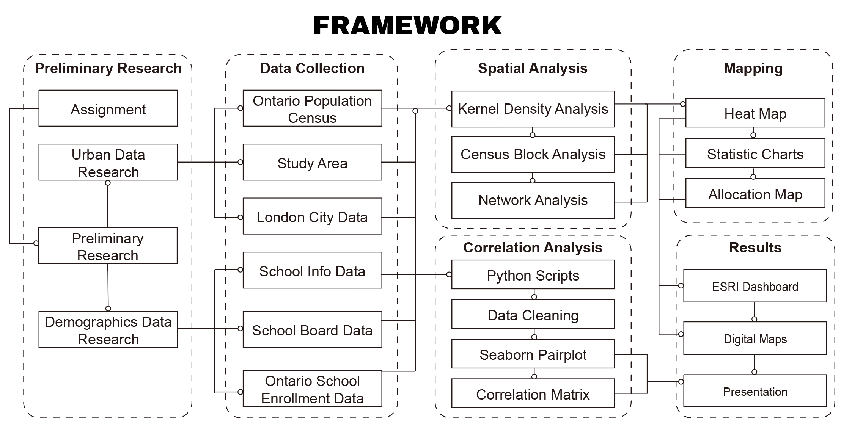
Framework and Dataset

Slide 5
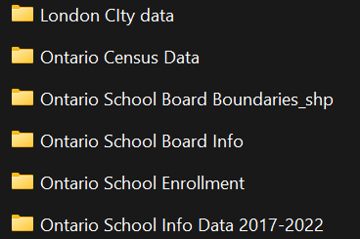
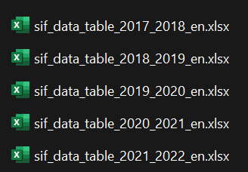
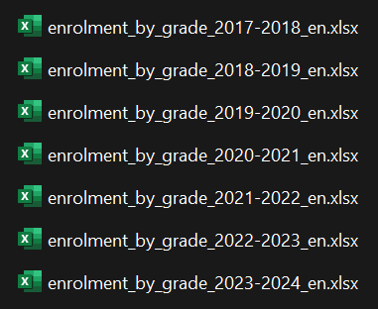
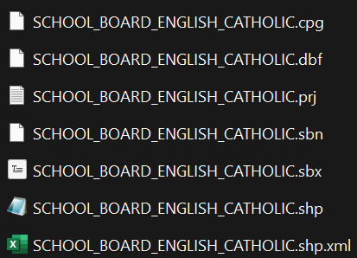




Framework and Dataset
Data collection
Land Information Ontario (LIO) Warehouse
Statistics Canada's Open Government Portal
Ontario GeoHub / Geospatial Ontario
London City Map Gallery
Education in Ontario
City of Toronto's Open Data Portal

Slide 6
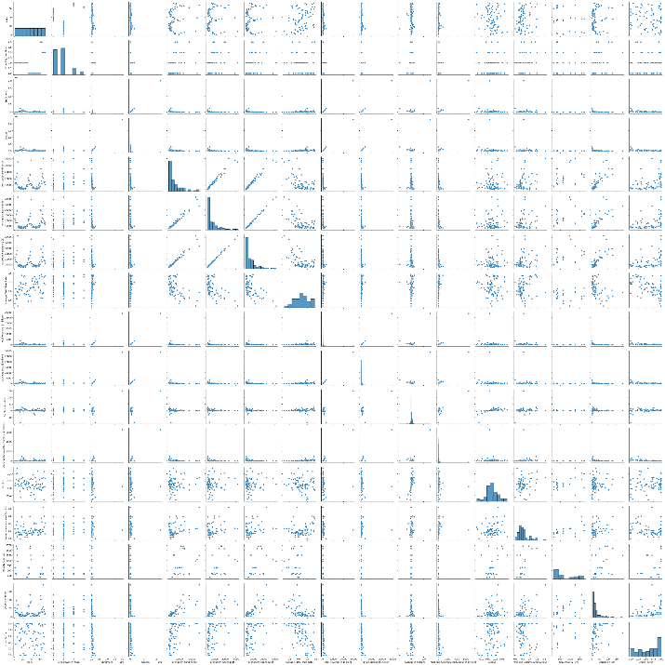
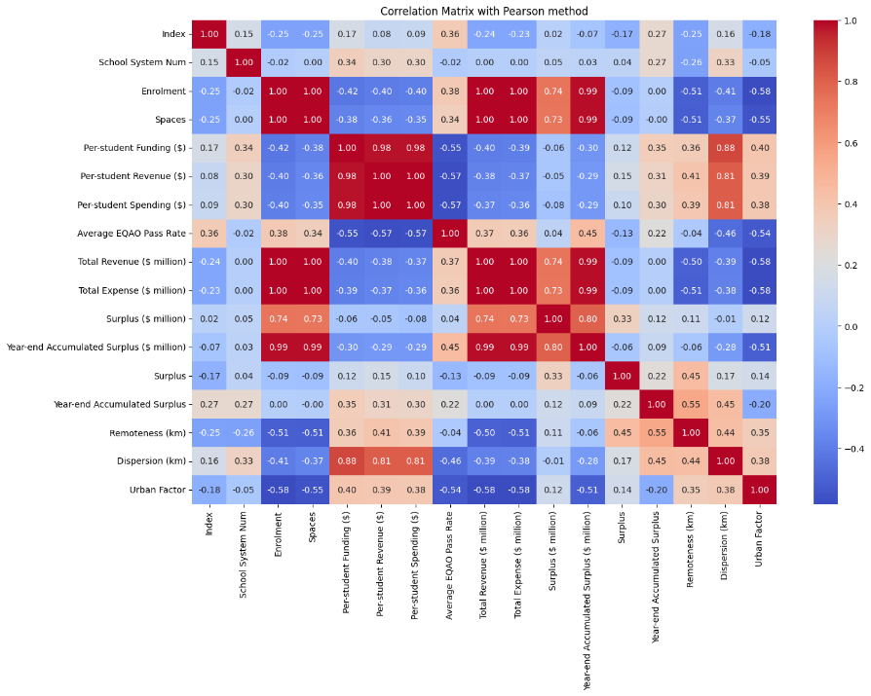
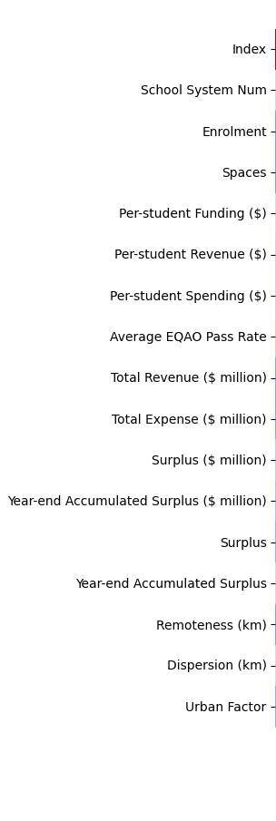
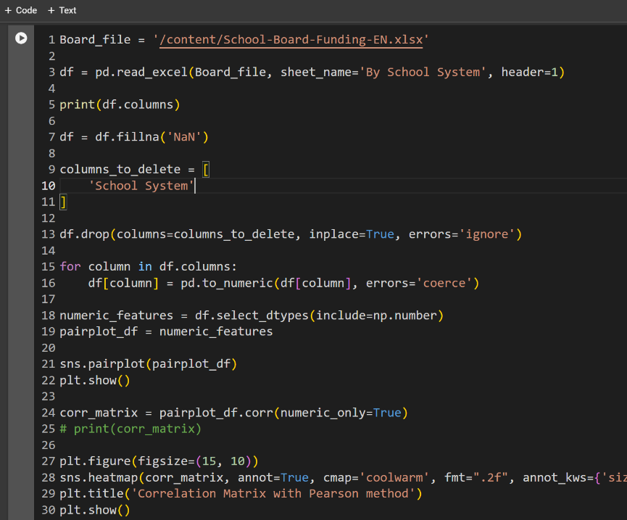
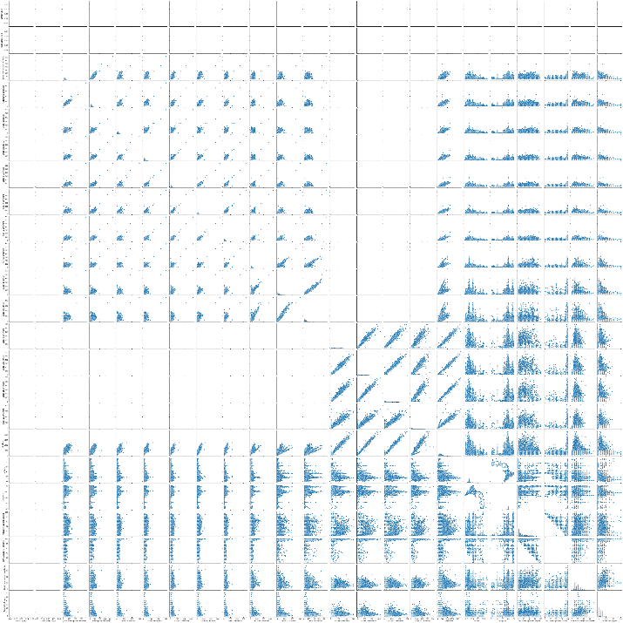
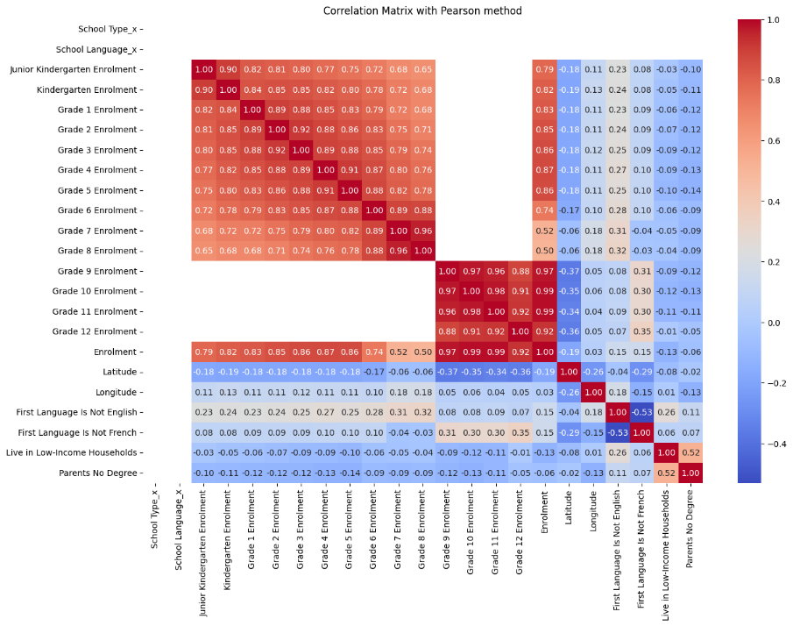

Correlation Analysis
Use Python to analyze the correlation between student enrollment and school information. Visualize the results using Pairplot and Correlation Matrix.
Urban factor and Remoteness
School Info and Board Data 2021
Python Codes
Student Enrollment Data 2021

Slide 7
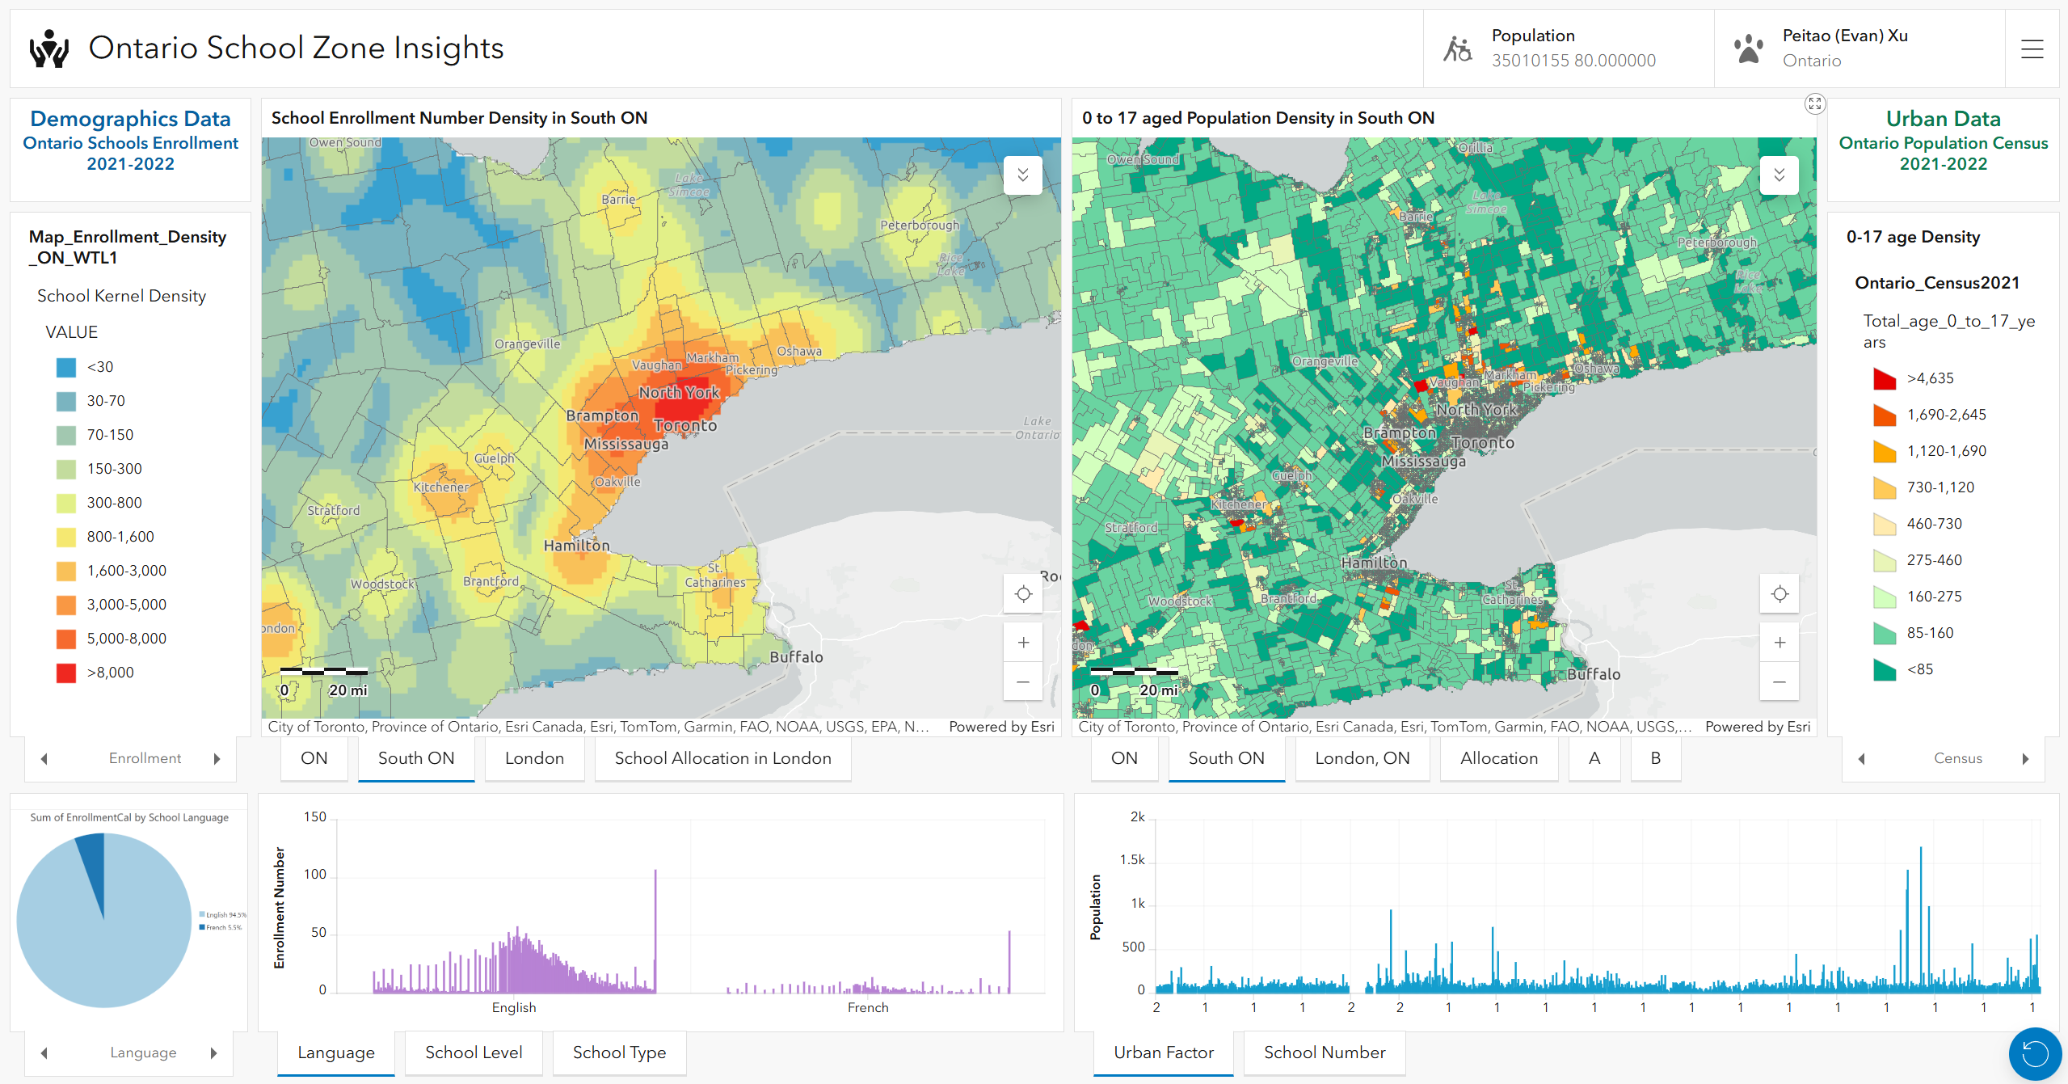




Urban data Research
ESRI Dashboard: Ontario School Zone Insights
Kernel Density Analysis
Population Census data
(for teenagers aged 0-17 )
(under Grade 12)
Three Level:
Ontario Province
Southern Ontario
London City

Slide 8
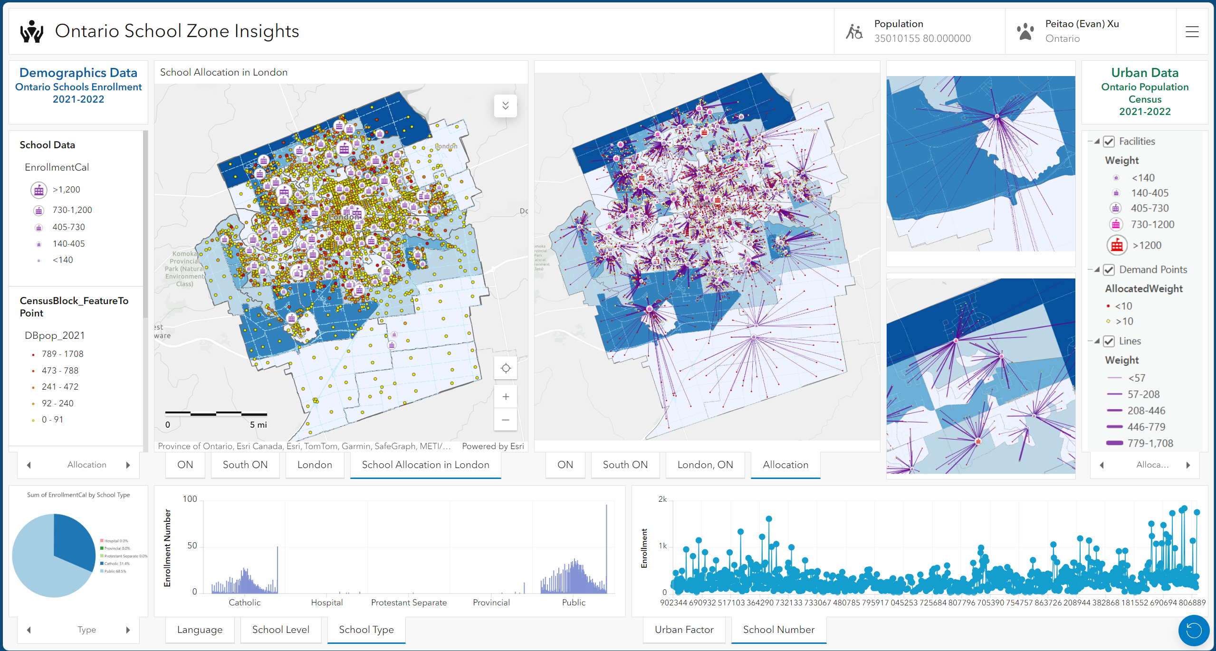
Urban data Research
ESRI Dashboard: Ontario School Zone Insights
Network Analysis
Location Allocation
Service Area
London Census Analysis
Focus on areas:
School with heavy burden (Red Icon);
High teenager density;
Remote Areas with Poor Accessibility

Slide 9
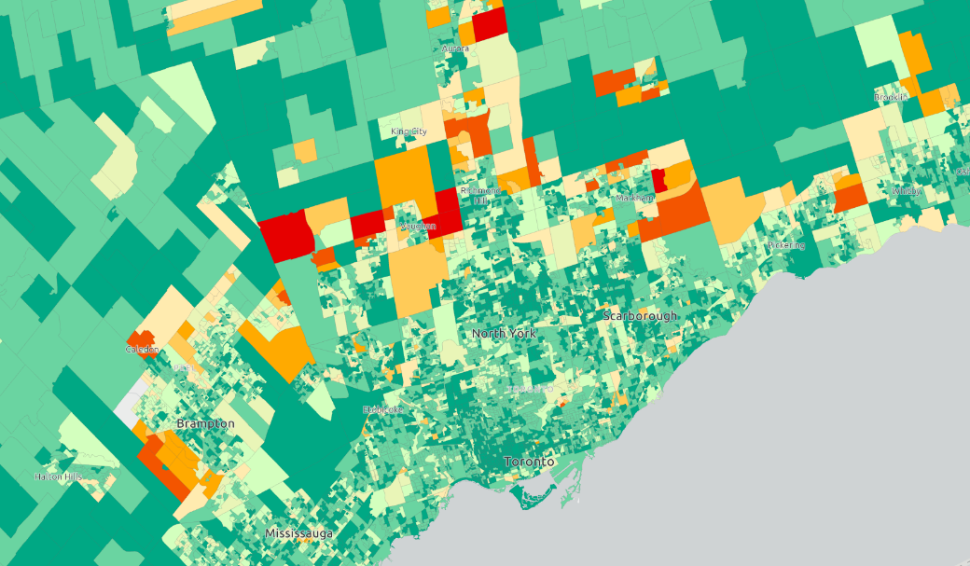
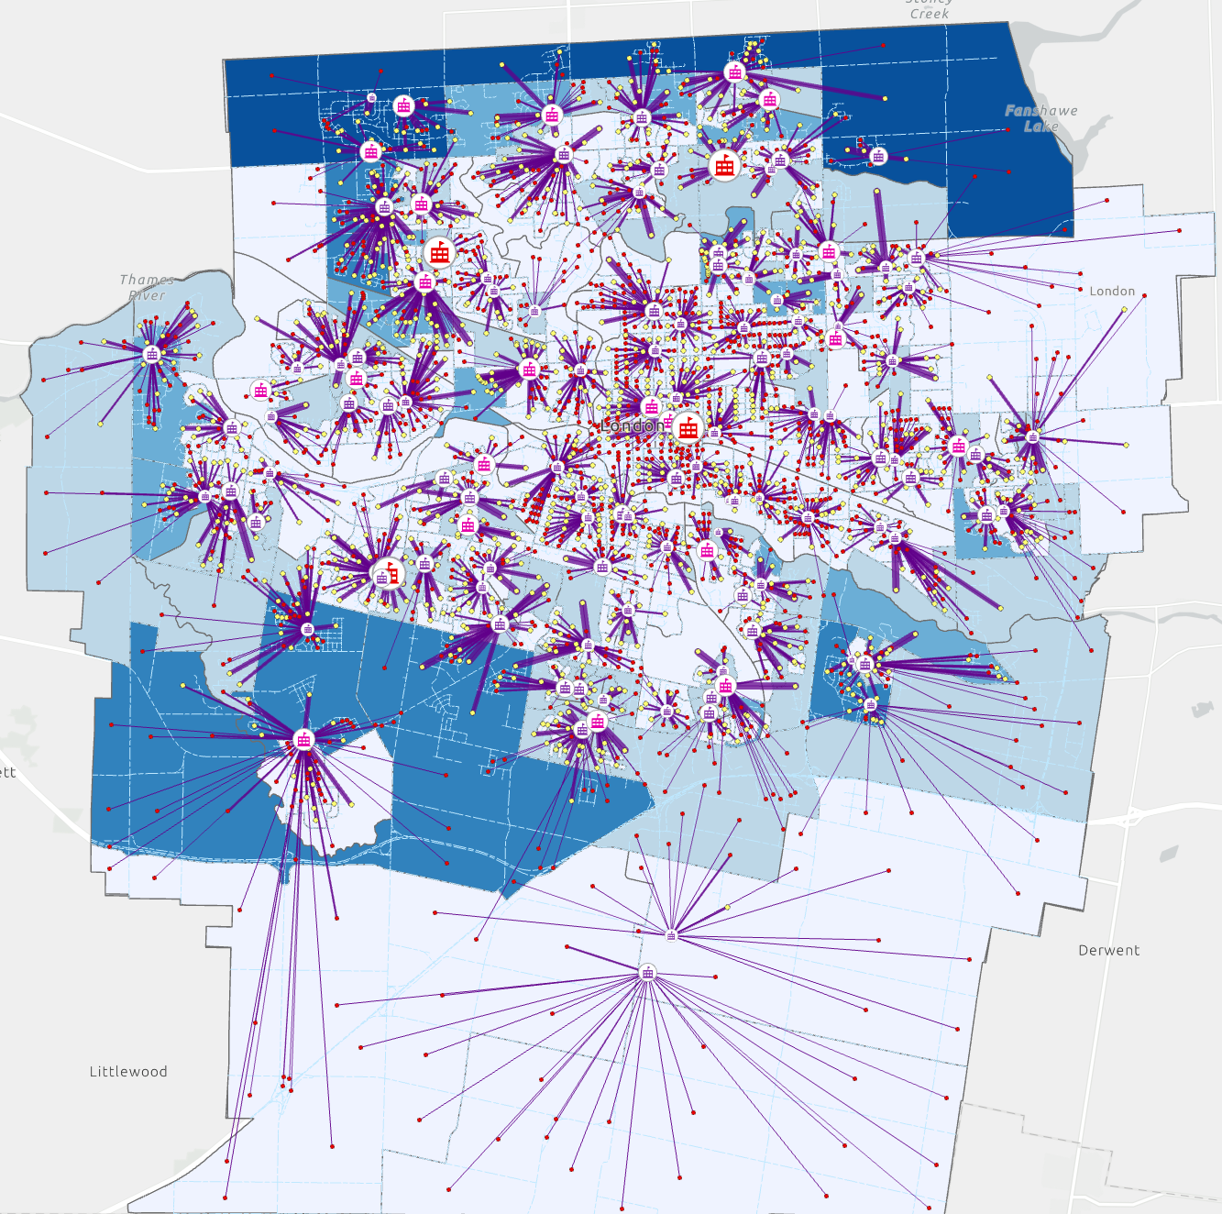
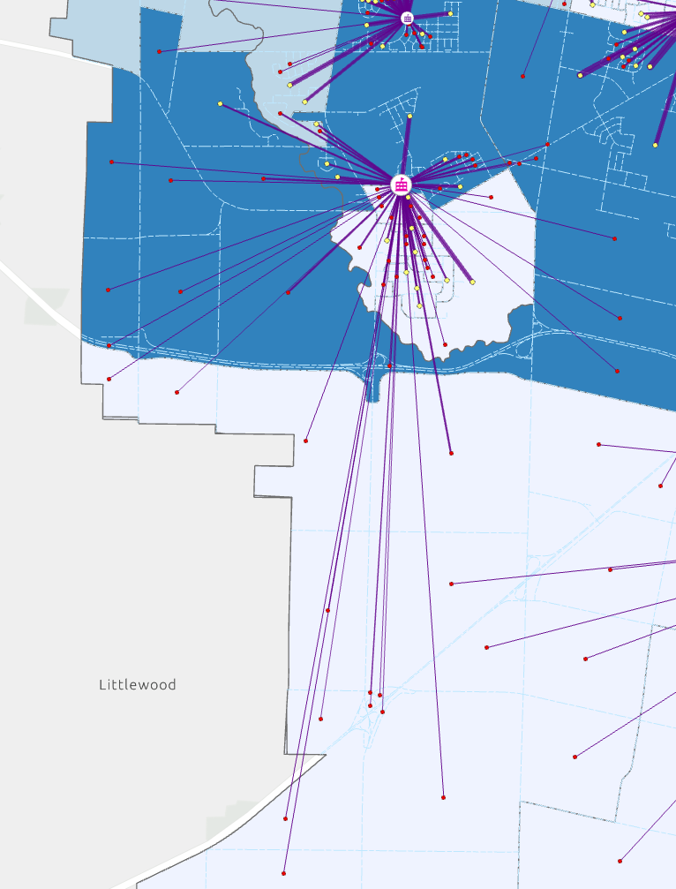
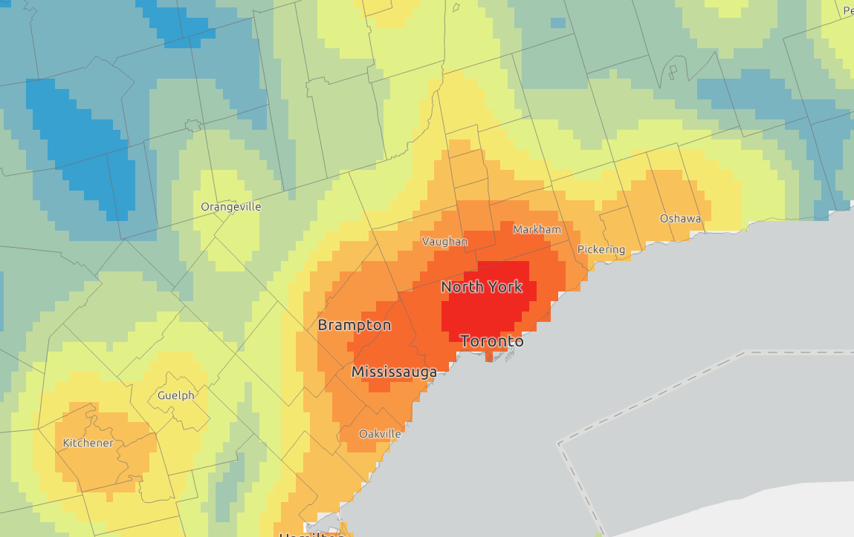
Urban data Research
ESRI Dashboard: Ontario School Zone Insights
Teenagers aged 0-17 Heat Map
Location Allocation Map
Schools Heat Map

Slide 10
Pre-Interview Assignment
Background:
You are a GIS Specialist with Community Services I & IT Cluster who is tasked with analysing and mapping geographic data related to schools in Ontario. The goal is to provide insights into school demographics, student enrolment patterns, and potential areas for new school construction. Outlining the methods and techniques you will use to perform spatial data analysis to achieve these objectives.
Results and Discussion
Key Finding:
Significant differences between Northern and Southern Ontario need to be considered.
Urbanization factors and transportation accessibility significantly impact enrollment data.
Some areas with high teenager density but few schools should be prioritized for new school construction and development, for example, London North/Southwest and New Market.
To assess the results of the analysis, governmental officers can consider the following criteria:
Interdepartmental Collaboration: Work with other Ministry departments (EDU, MMAH, etc.).
Community Input: Gather feedback from educators, parents, and community members.
Resource Requirements: Assess feasibility based on existing resources (budget, infrastructure).

Slide 11
Pre-Interview Assignment
Background:
You are a GIS Specialist with Community Services I & IT Cluster who is tasked with analysing and mapping geographic data related to schools in Ontario. The goal is to provide insights into school demographics, student enrolment patterns, and potential areas for new school construction. Outlining the methods and techniques you will use to perform spatial data analysis to achieve these objectives.
Results and Discussion
Potential Future Consideration:
Long-Term Data Collection: Include data from longer time periods to provide a more comprehensive analysis.
Time-Sensitive Predictive Modeling: Based on the expanded data, develop a time-sensitive machine learning neural network model, which can learn from past data and predict future changes in youth population and enrollment numbers.
Transportation Impact Analysis: Integrate Bus Route Analysis within the Network Analysis to get more accurate Location Allocation values. This will the transportation accessibility is adequately addressed in the analysis.

Slide 12

OPS · MPBSDP · CSC
Data Product Services Branch
GIS Specialist
(Job ID 220807)
Thank You
Peitao ( Evan ) Xu
peitao.xu@outlook.com
(548) 888 6071
WIN ID # 529227
2024 - 12 - 12

Slide 13



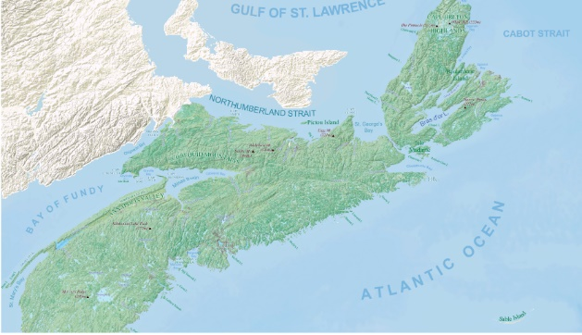
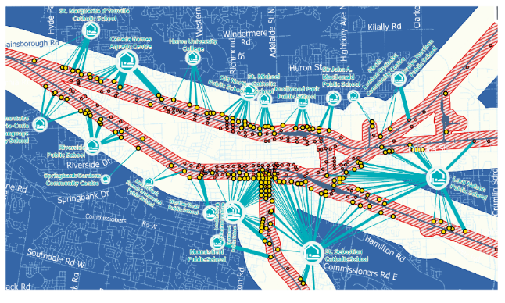

Introduction Overview
01
Self Introduction
04
Signboard Lens
in Urban Streets
02
NAPS Automation Project
(MECP)
05
Landforms of Nova Scotia / West London
03
Train Derailment
Evacuation Planning Maps
06
Graffiti Intelli-Sence
Web Design Project

Slide 14




Slide 15



Slide 16

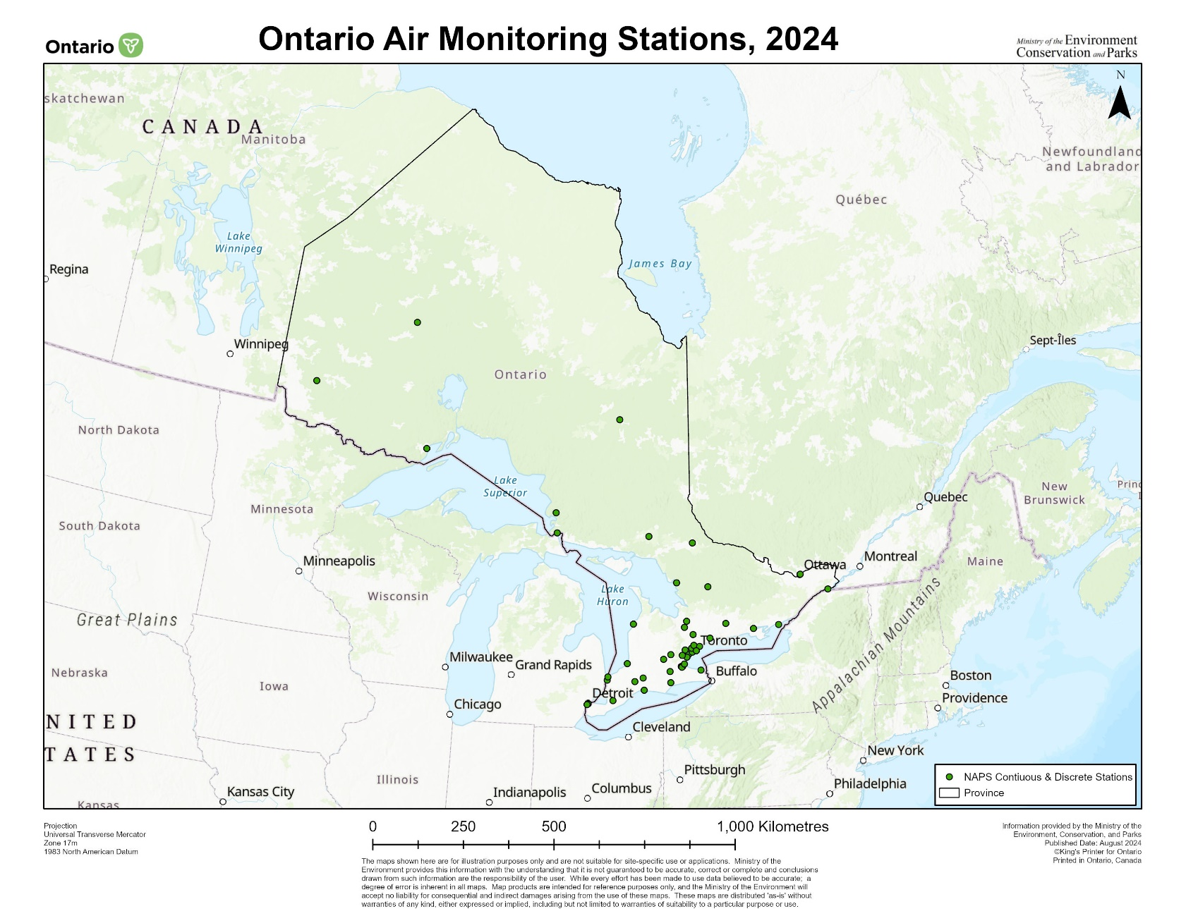
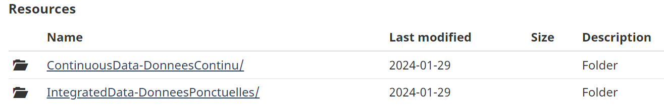
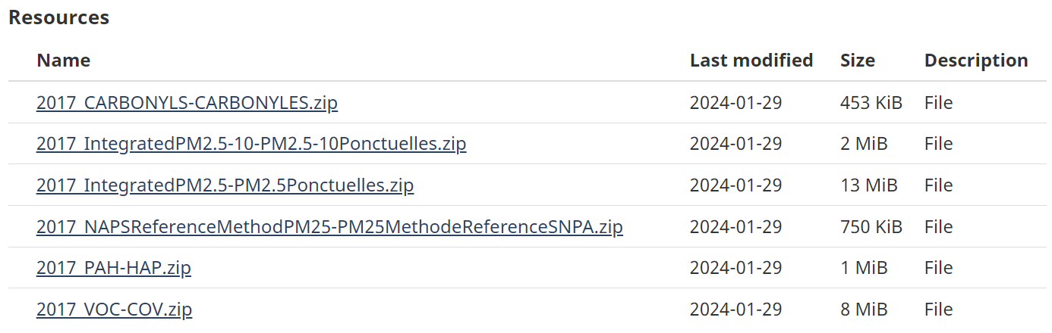
01. NAPS Automation Project (MECP Intern)
Automatically download The National Air Pollution Surveillance (NAPS) ¹ data from ECCC, classifying all contaminant parameters with automated flows, including data cleaning and processing, before it is sent to Tableau for analysis, reducing analysis time by 60%.
¹ Reference: Environment Canada, National Air Pollution Surveillance (NAPS) Program

Slide 17
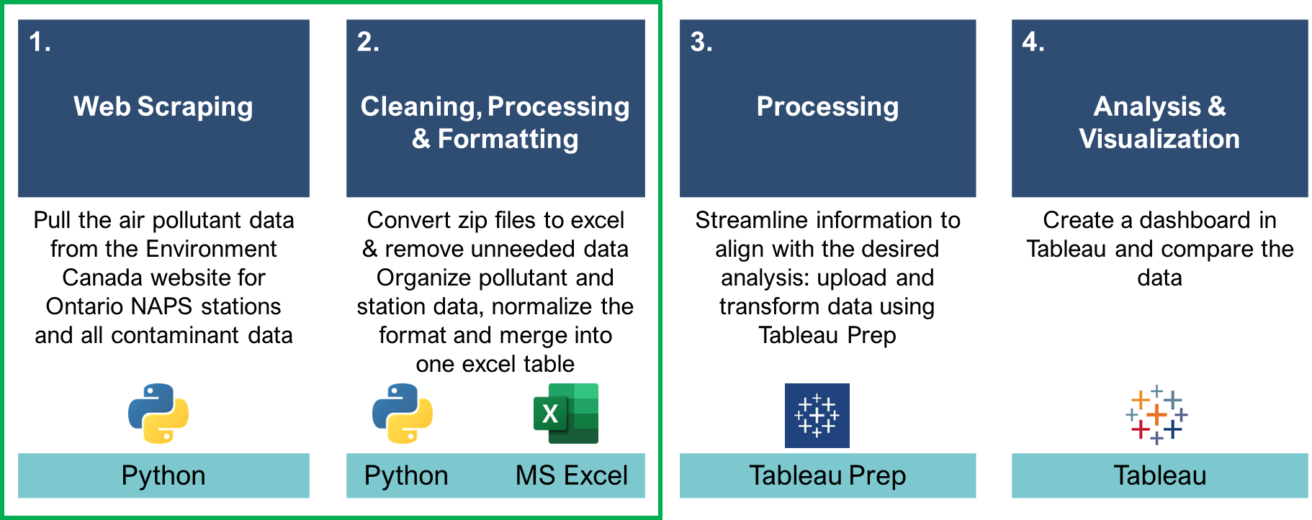
01. NAPS Automation Project (MECP Intern)
Effectively collaborated in a team of six and provided weekly updates on project progress to my supervisor.
Met deadlines by completing the automated data processing for five regions in Ontario within three months and created detailed presentations and documentation to introduce the workflow to team members and the manager.
Worked with both internal and external team members to complete a presentation for the Deputy Minister's office.

Slide 18
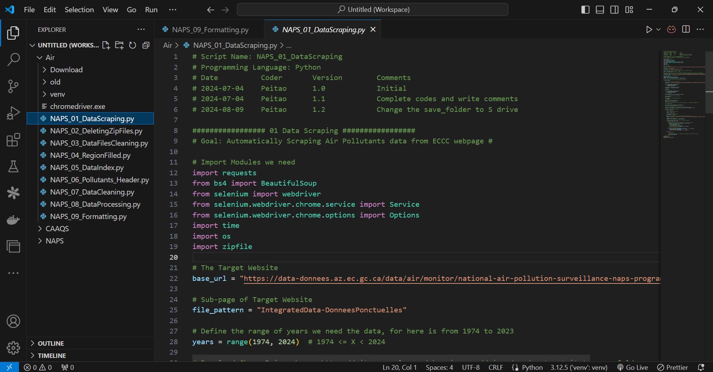
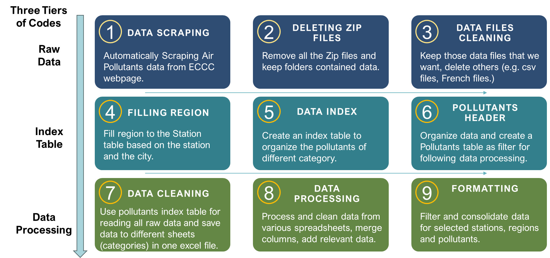
01. NAPS Automation Project (MECP Intern)

Slide 19
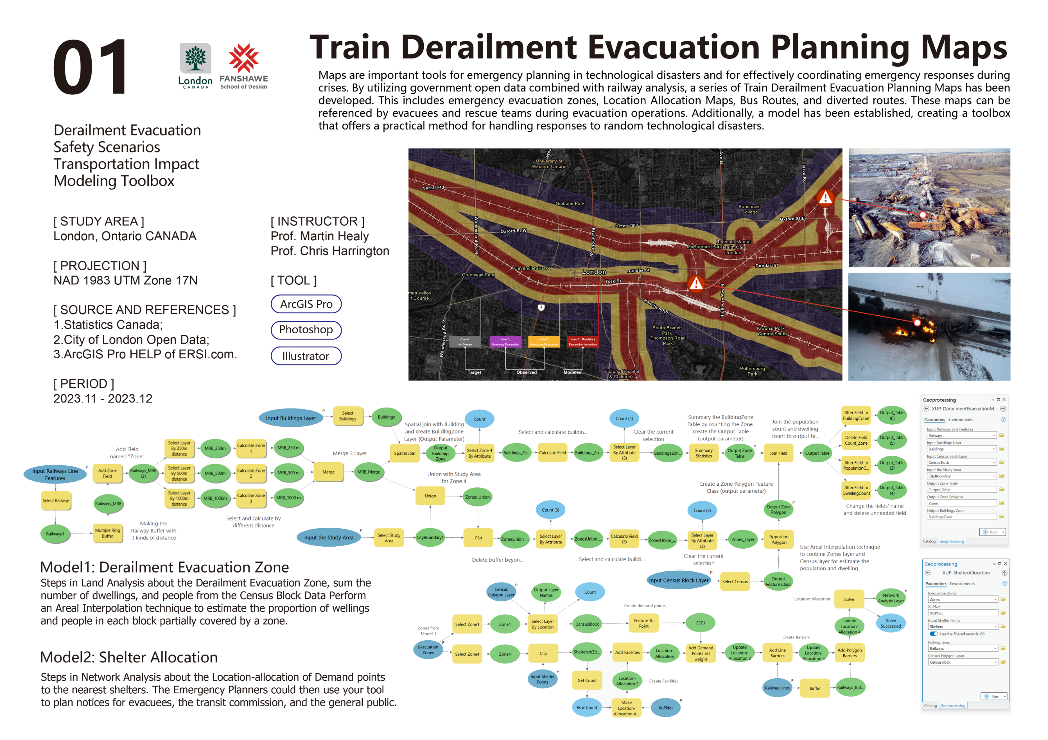


Slide 20
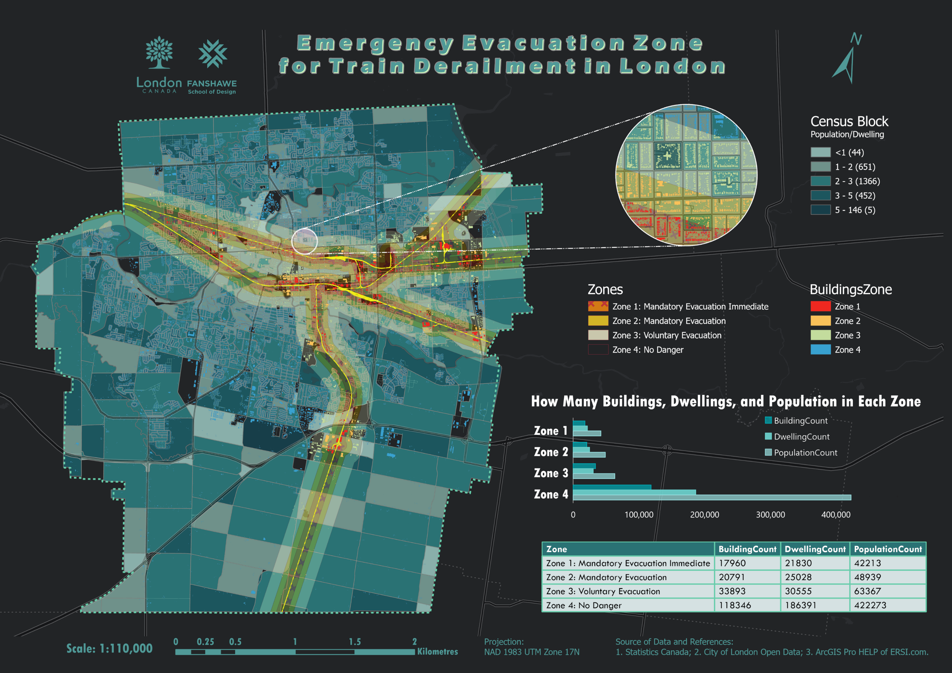

Slide 21
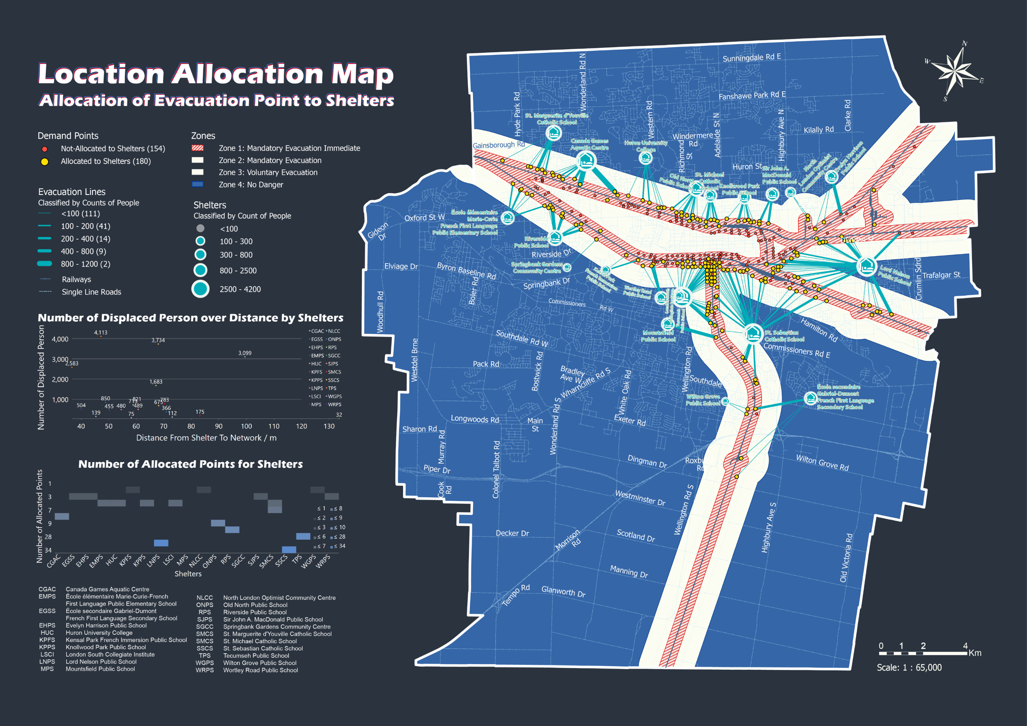

Slide 22
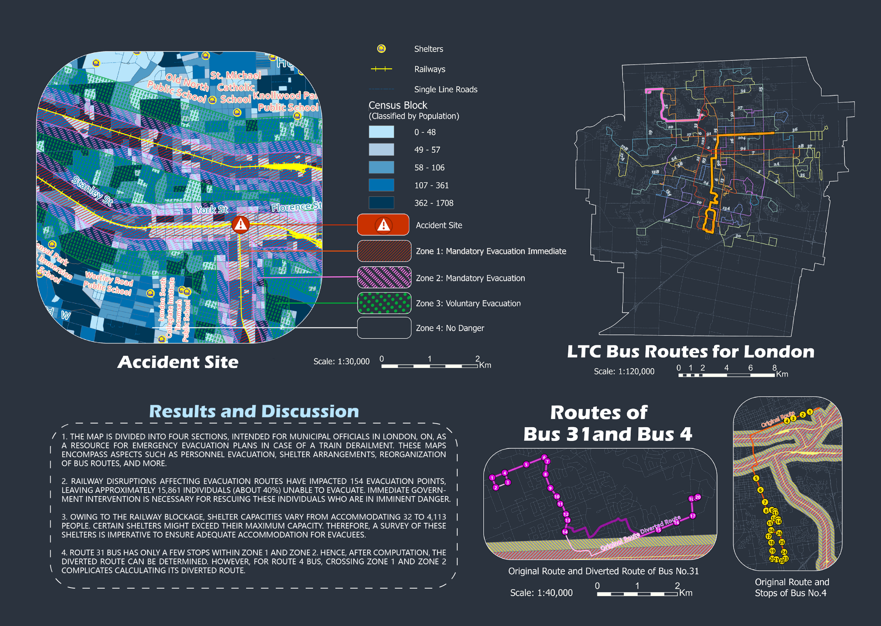

Slide 23


Slide 24
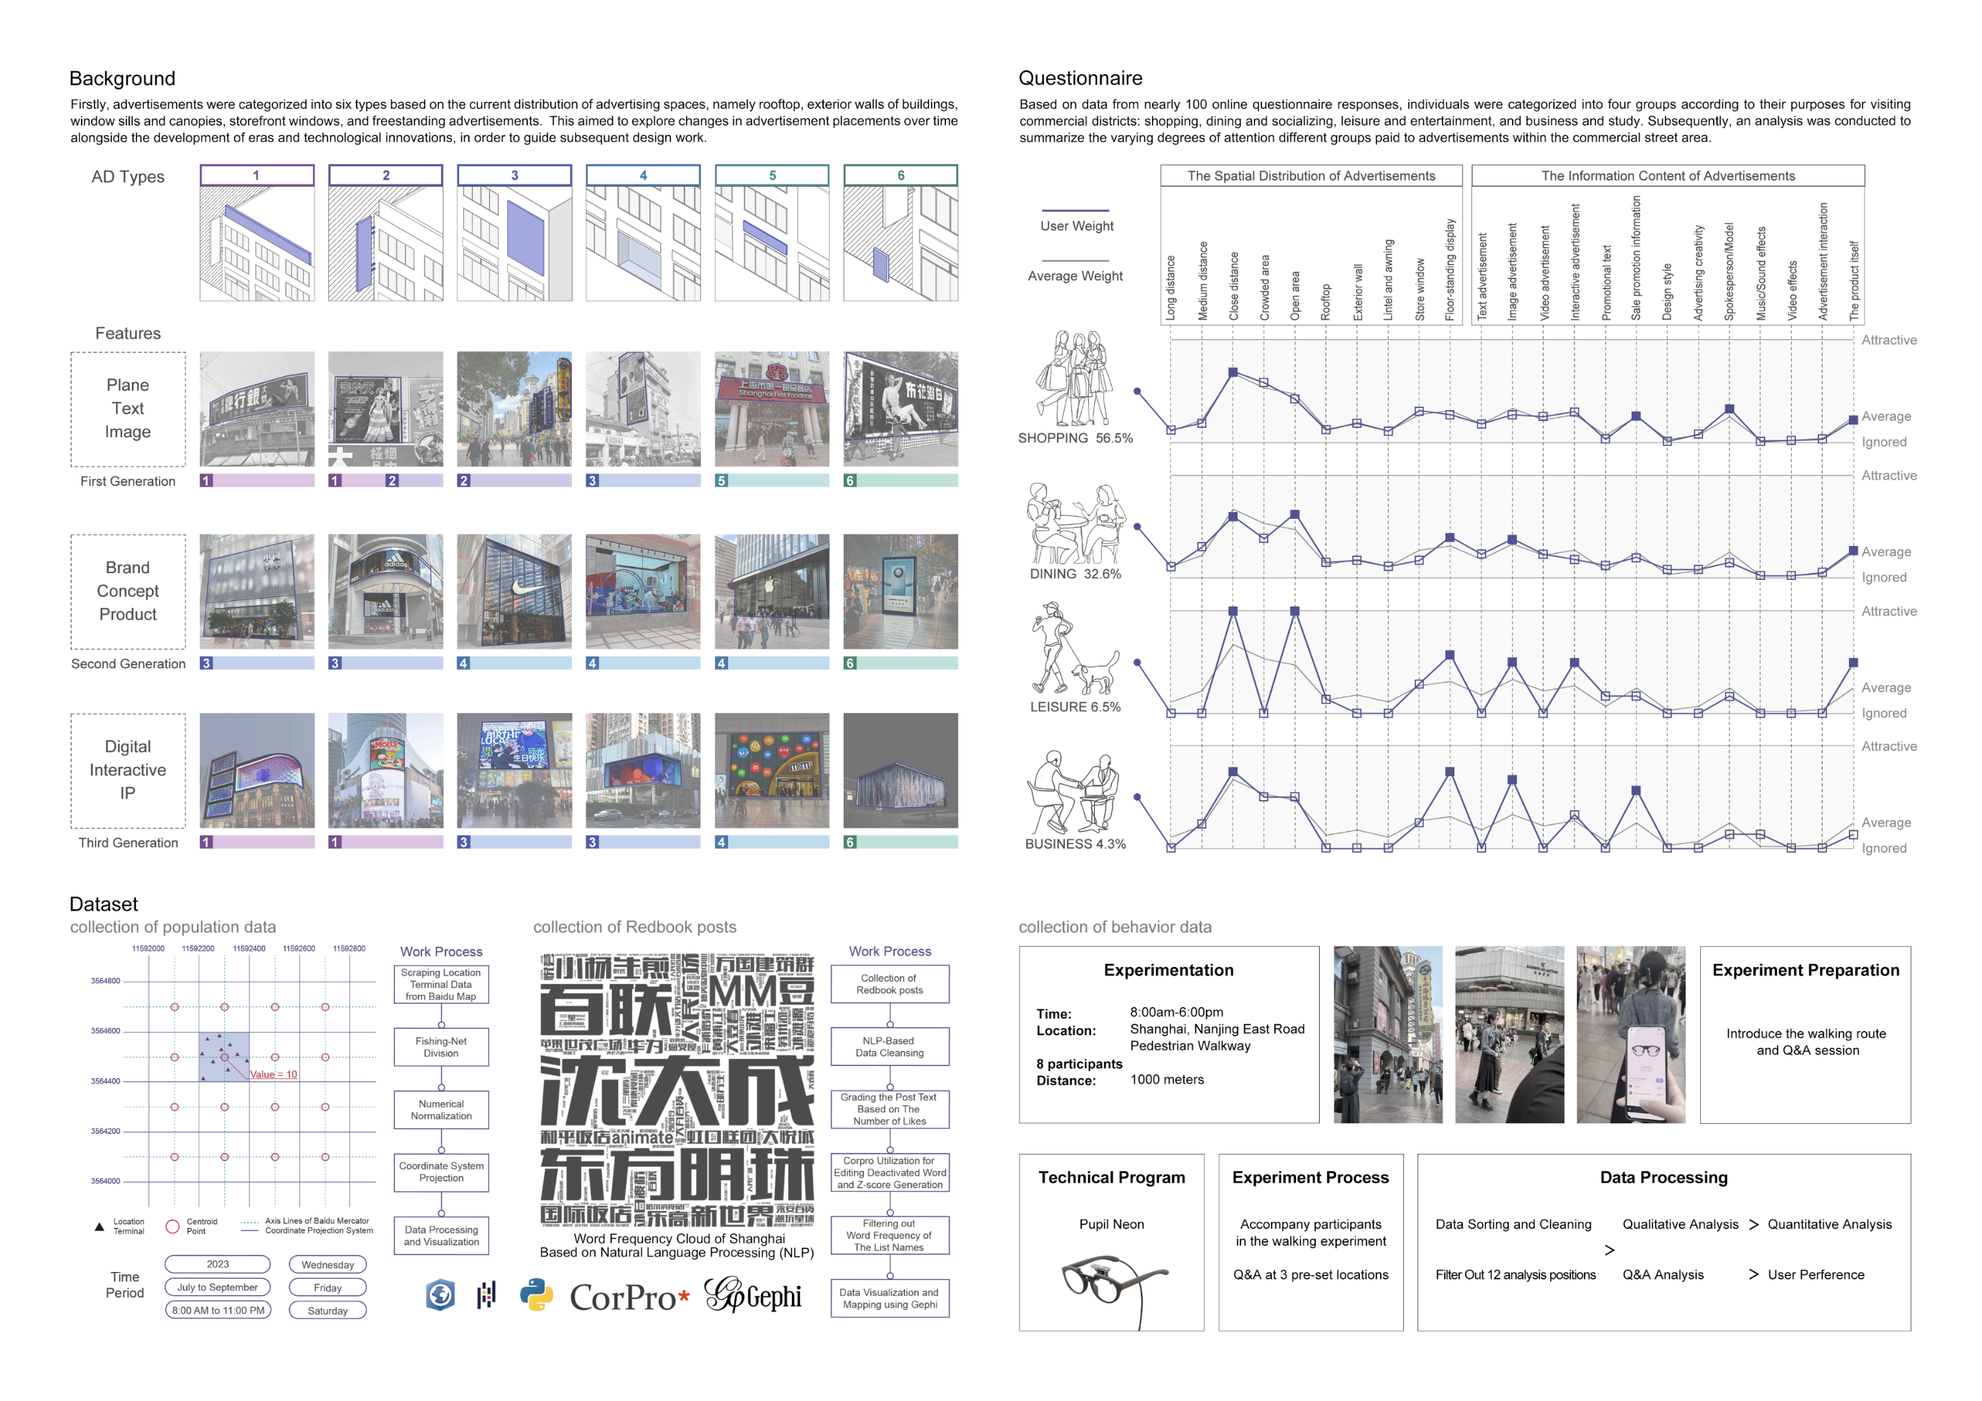

Slide 25
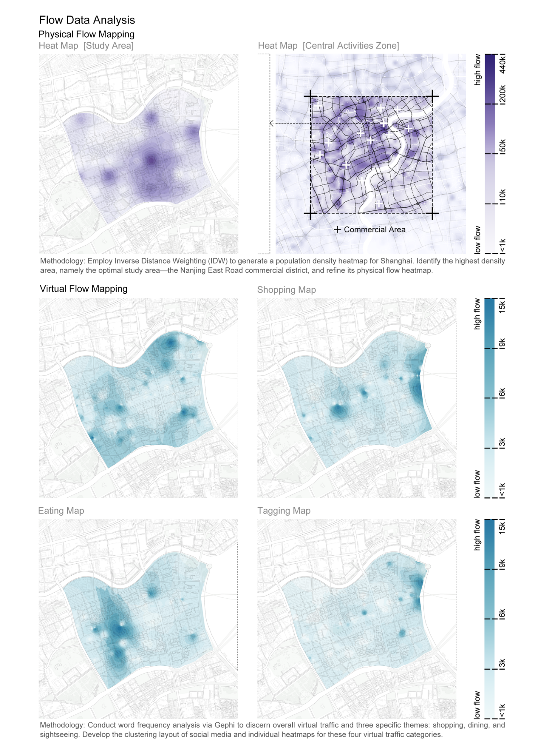


Slide 26
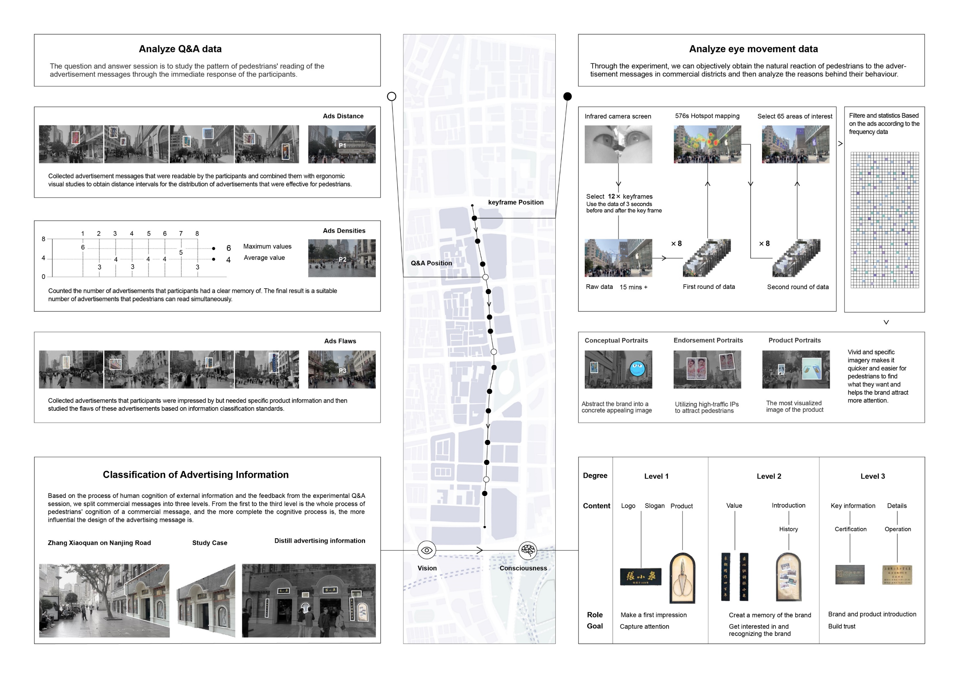

Slide 27
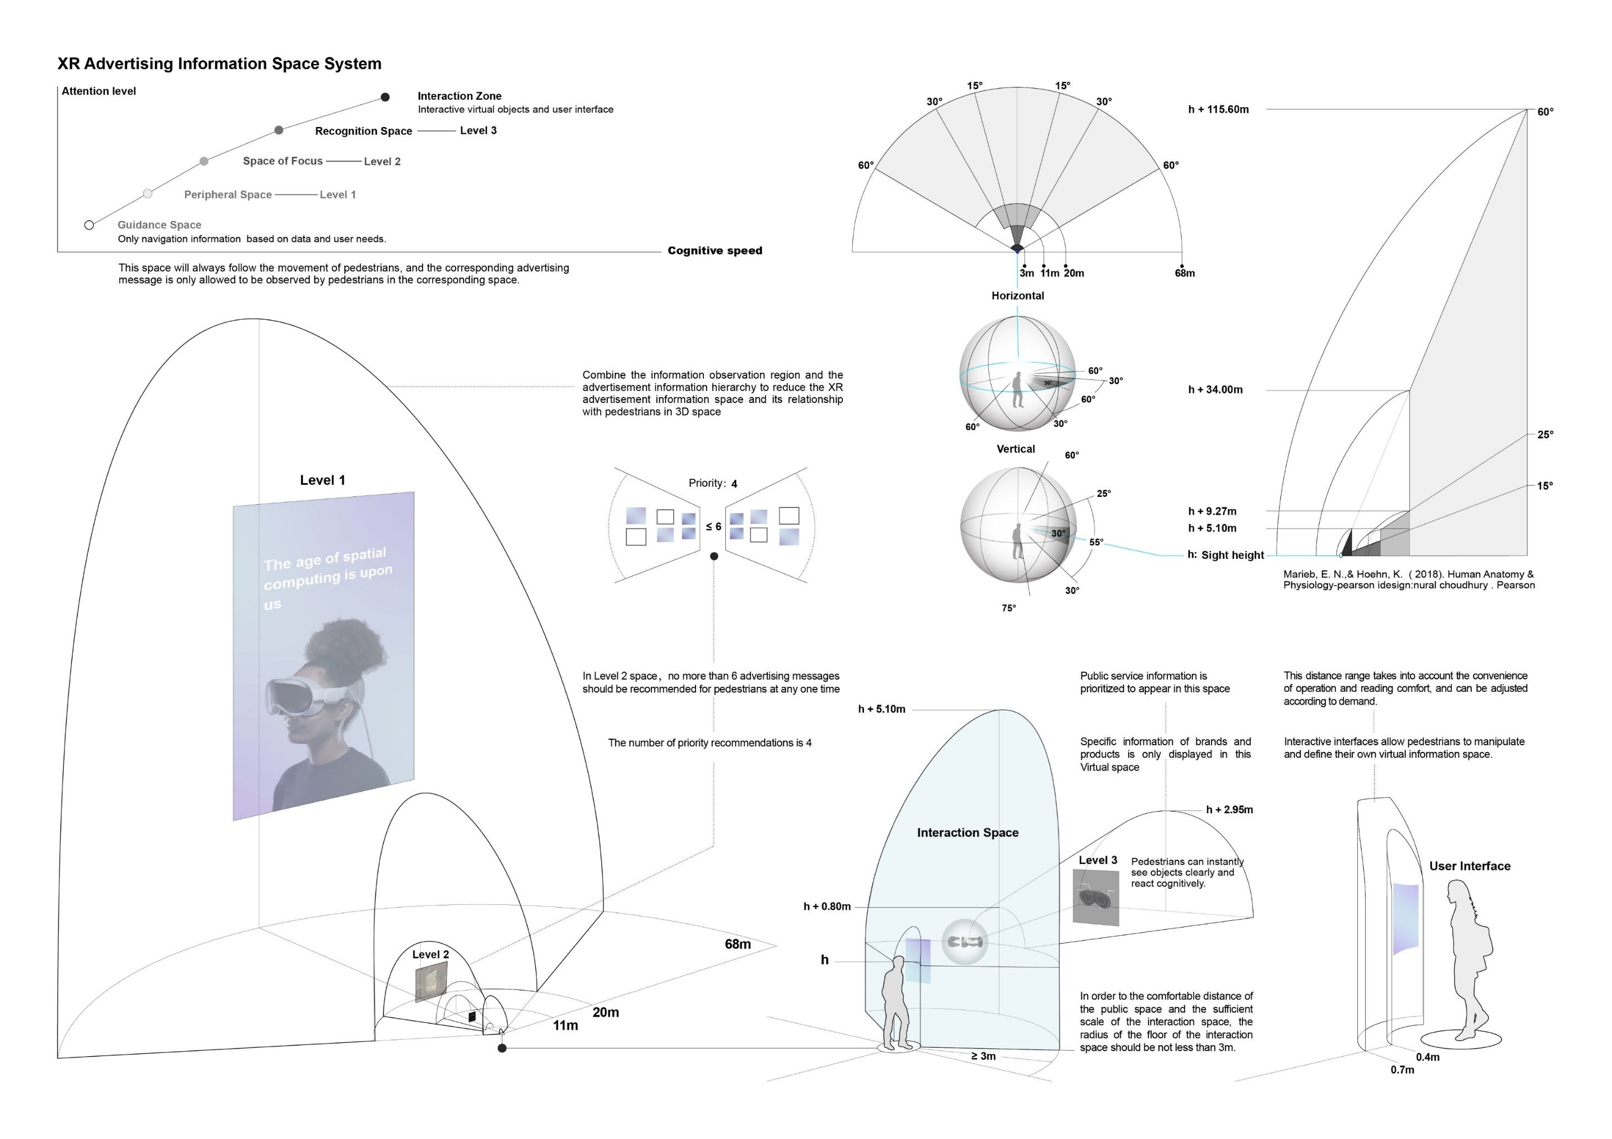

Slide 28
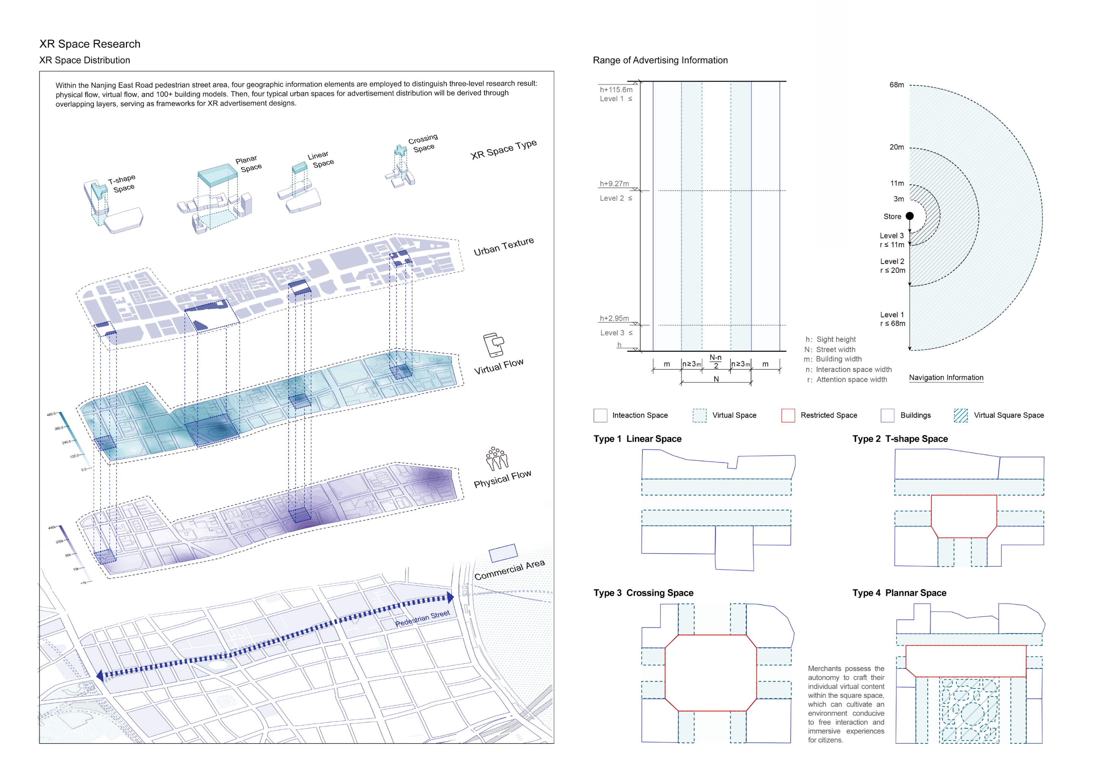

Slide 29
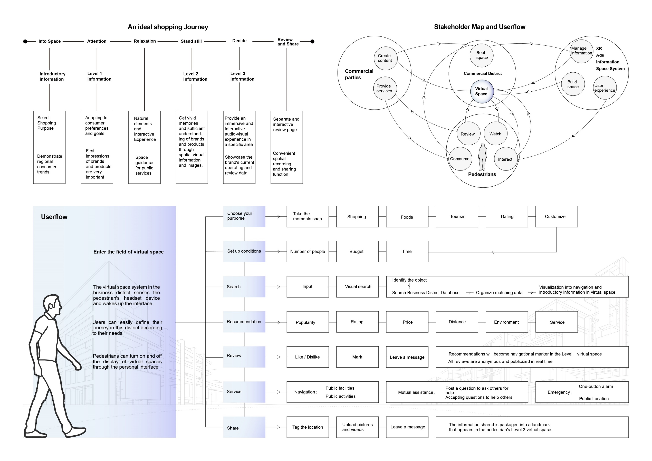

Slide 30
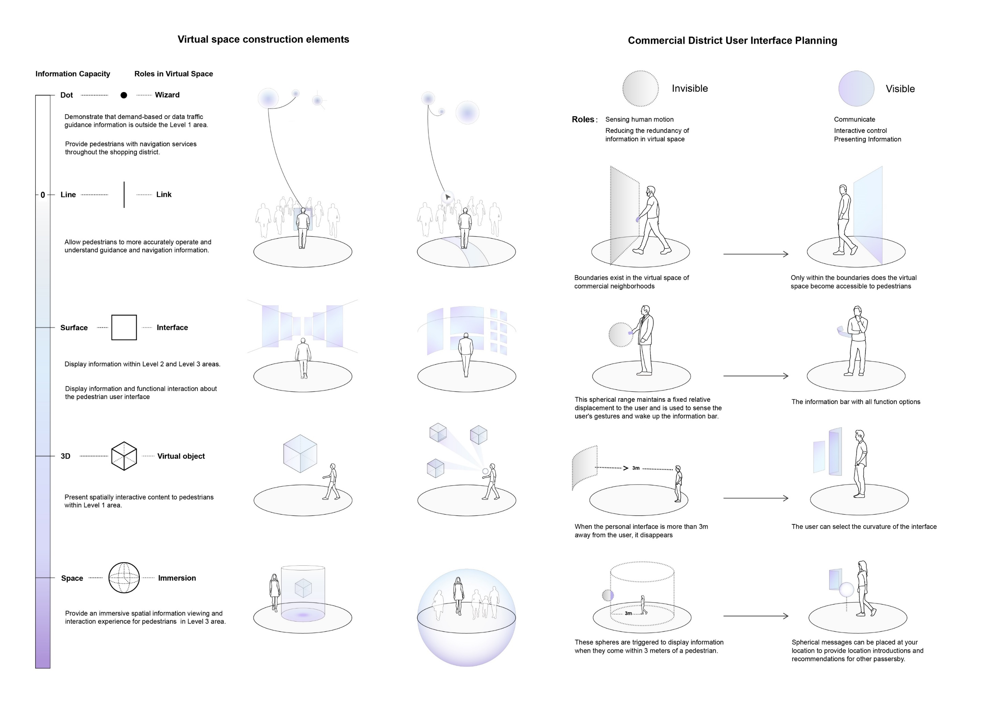

Slide 31


Slide 32
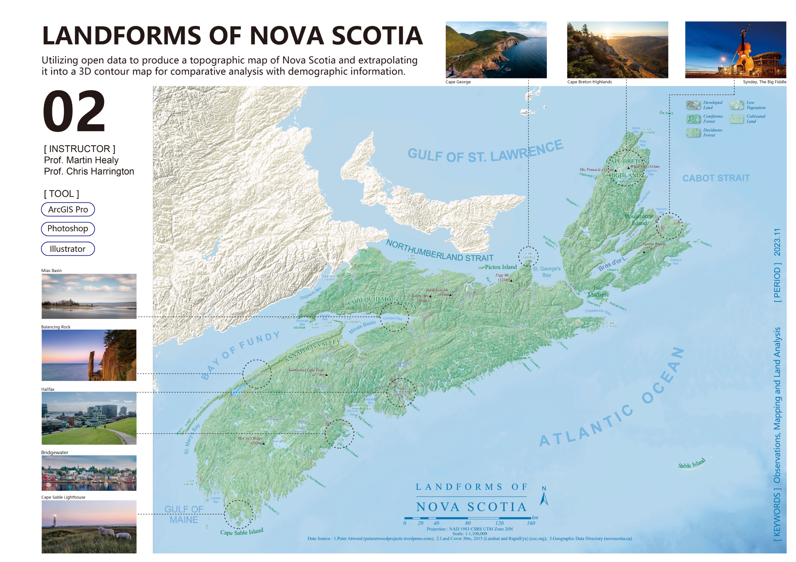


Slide 33
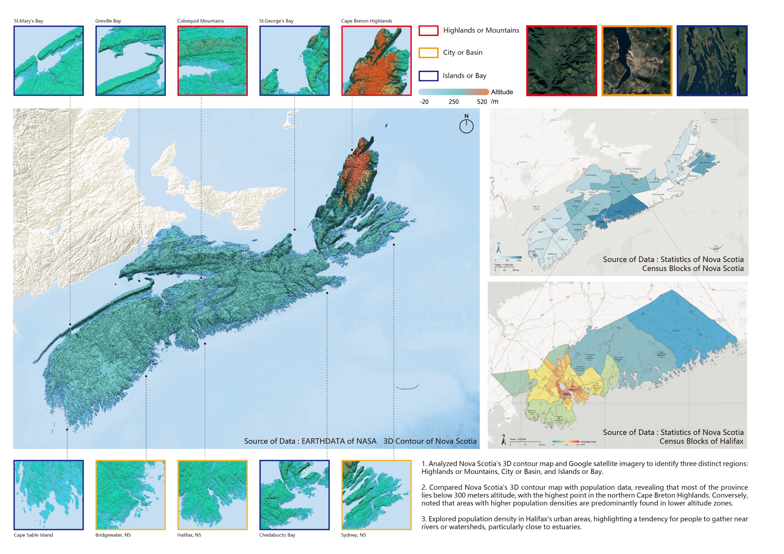

Slide 34
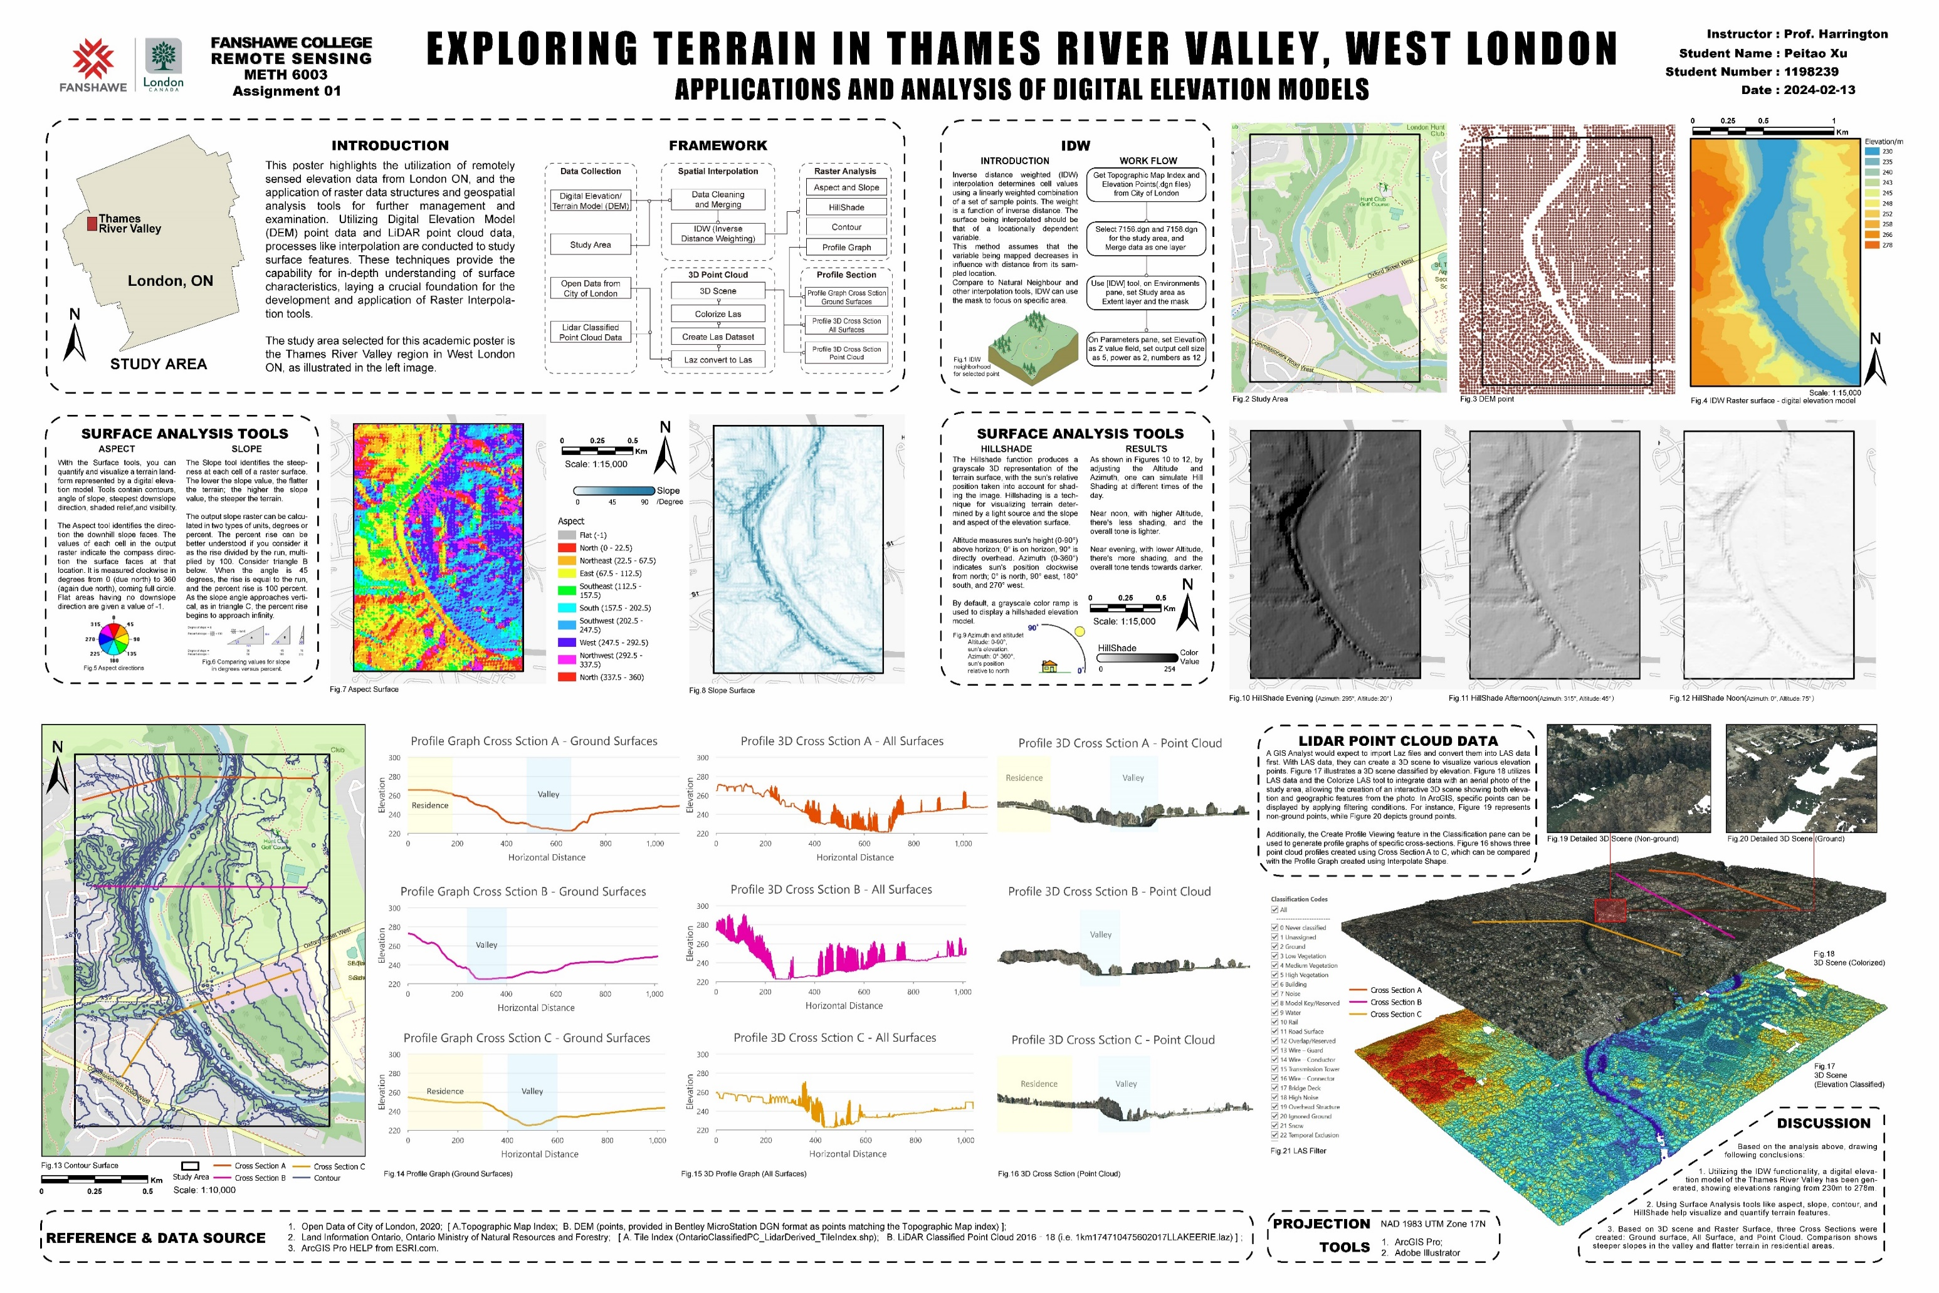

Slide 35
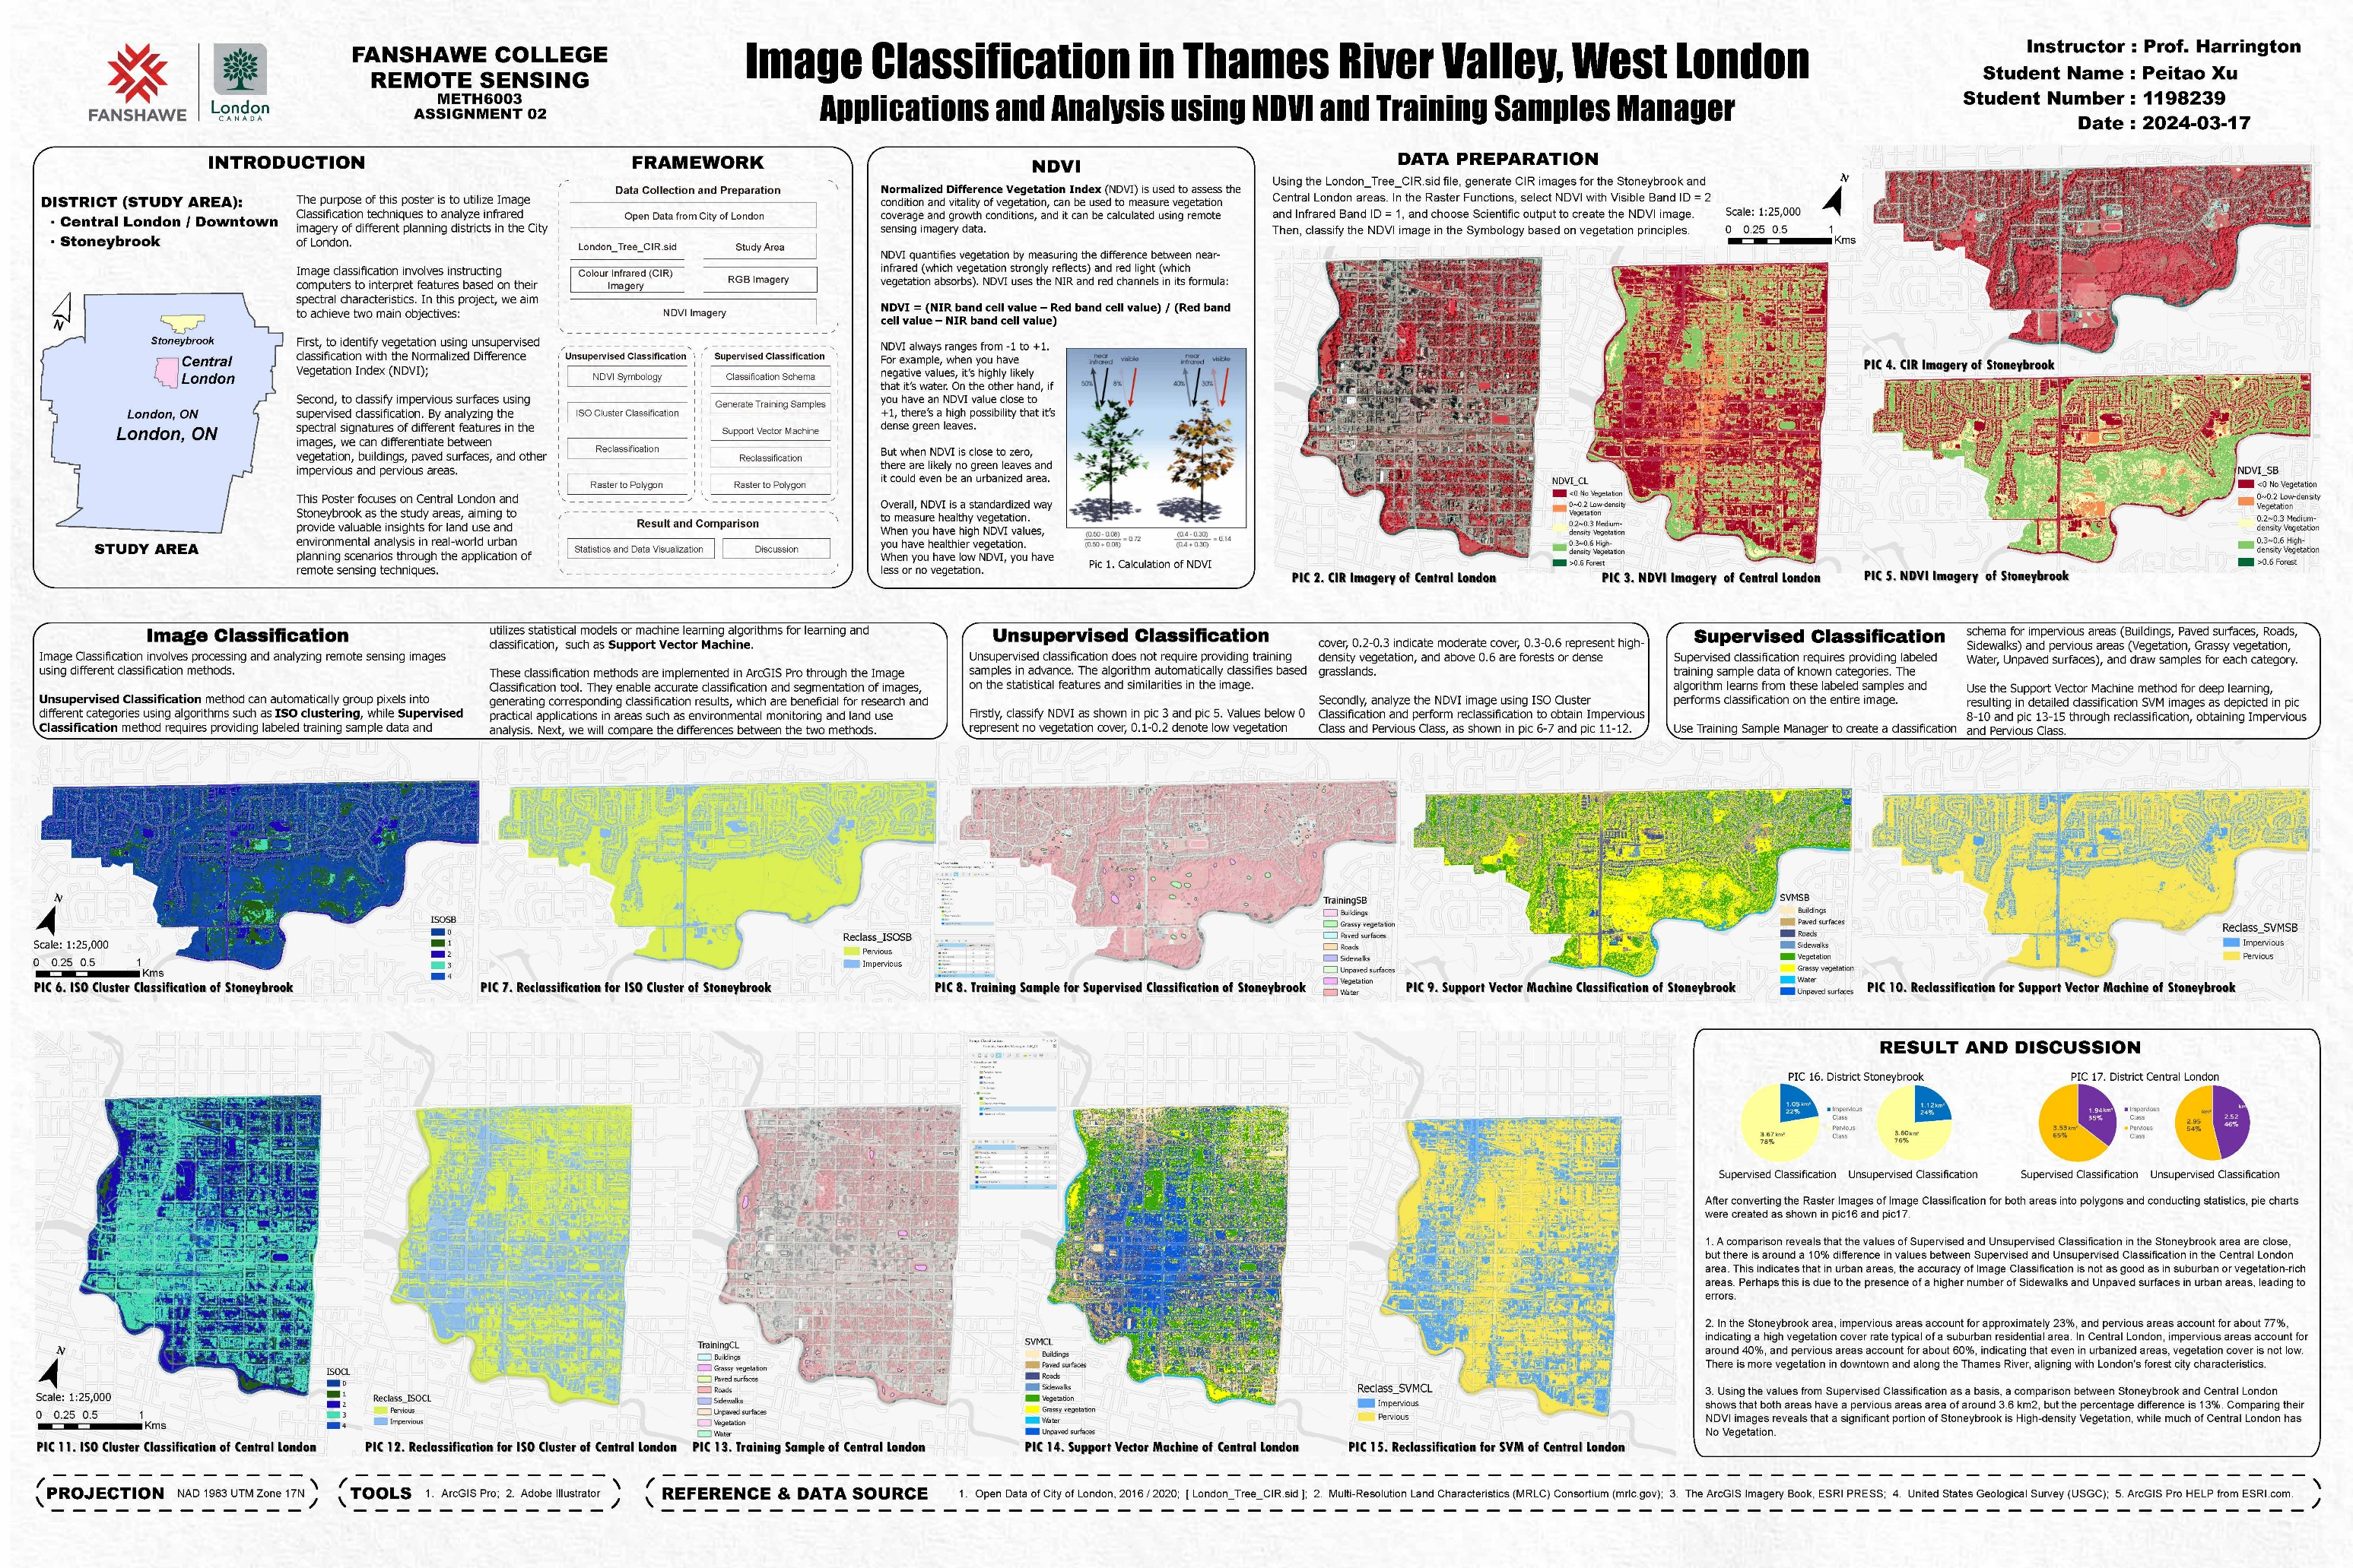

Slide 36
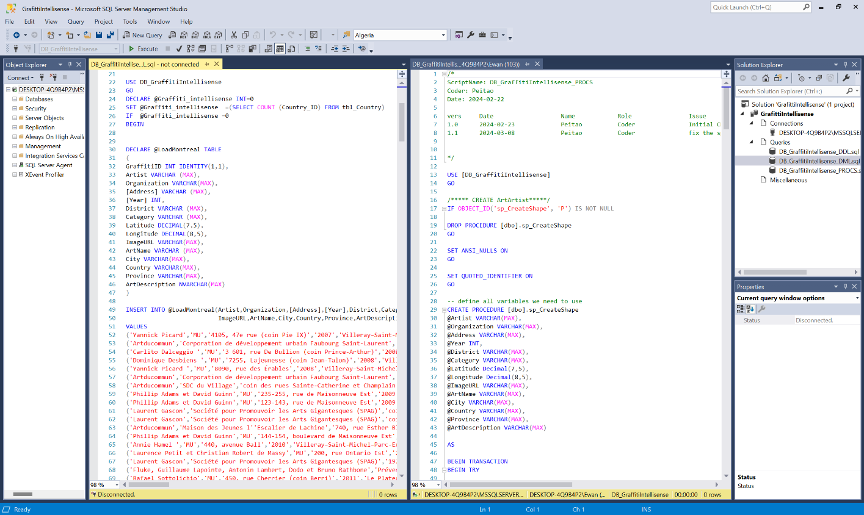
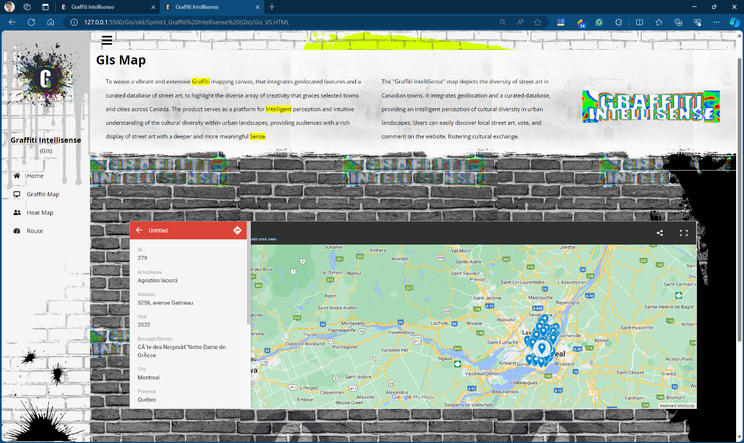

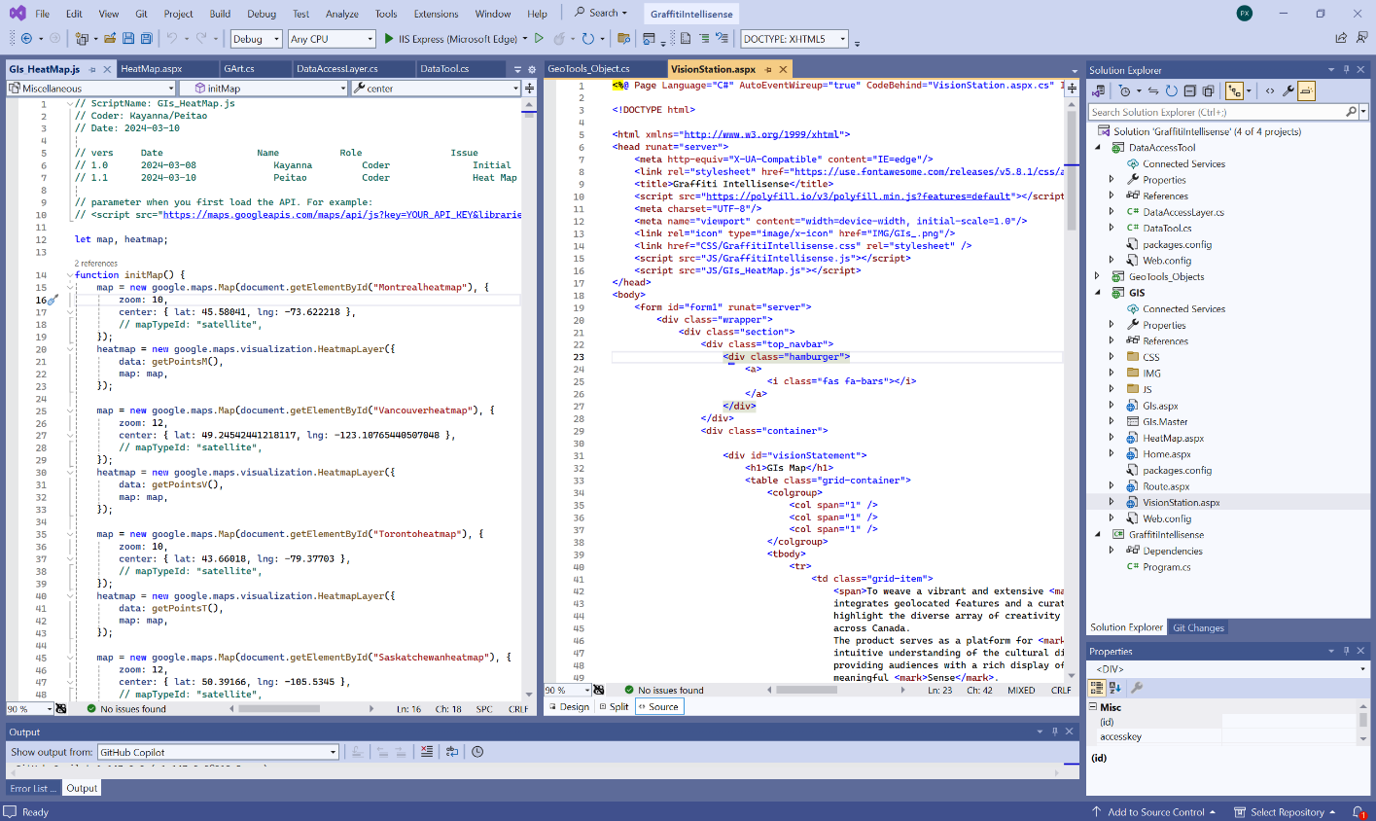
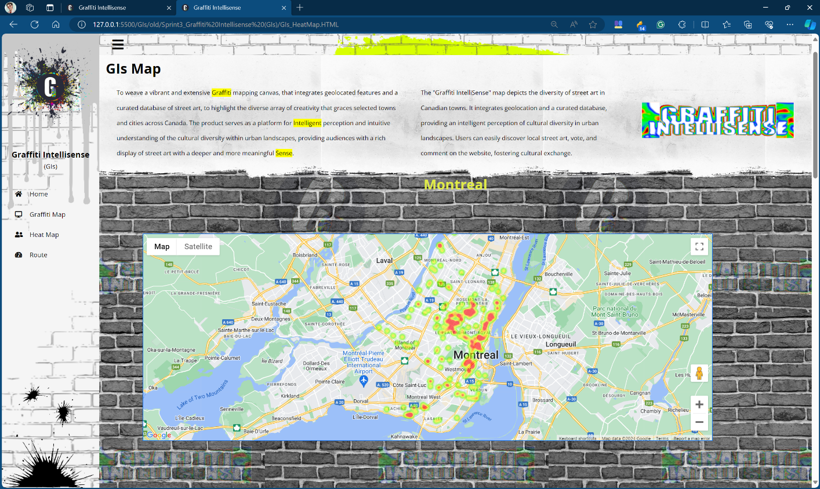
05. PROJECT - GRAFFITI INTELLISENSE
The product serves as a platform for Intelligent perception and intuitive understanding of the cultural diversity within urban landscapes, providing audiences with the rich display of street art with a deeper and more meaningful Sense.
Points Map
SQL Database
Heat Map
C#, HTML, JavaScript, Google Map API

Slide 37
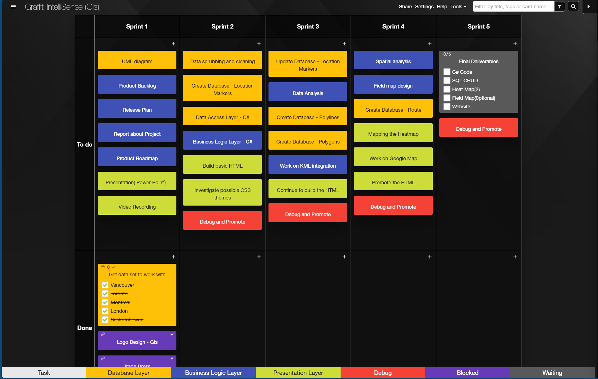
PROJECT - GRAFFITI INTELLISENSE : Product Backlog
Graffiti IntelliSense (GIs) - Graffiti IntelliSense - Kanban Tool
Each Sprint
To-do Box
Done Box
Tags

Slide 38






Focus on
Science
Technology
Data Analysis
But Also Care about
Human
Rights
Diversity (LGBTQIA+)
Public Services
Climate Change

Slide 39
What Skills the position Need
Technical skills:
• You have strong knowledge of GIS theories, principles, practices, application and methodologies, including data collection, conversion, manipulation, storage, maintenance, libraries and data management.
• You have a comprehensive understanding of digital map production concepts, raster and vector data models, map projections, datums, scale, resolution, layering, accuracy and precision.
• You have demonstrated knowledge of GIS programming tools in a Windows and UNIX environments.
• You have excellent, demonstrated knowledge of GIS software including ESRI products related to map display, query and editing, data management, data integration, data conversion, and data analysis.
• You have working knowledge of structured programming (R, Python).
• You have a solid understanding of SQL Server or Oracle for data structuring, storage, and querying, including reporting functions and, data extraction.
• You have working knowledge of Microsoft Business Intelligence/Data & Analytics software for evidenced-based reporting.
Analytical and evaluative skills:
• You have evaluative skills to assess client needs and requirements, interpret results, and determine appropriate solutions.
• You can analyze data using a variety of methodologies and techniques (e.g. spatial analysis) and compile, produce and maintain geographic datasets.
Communication and interpersonal skills:
• You can communicate effectively with managers, staff, internal and external clients, and service providers to share information and resolve issues.
• You can write clearly to convey highly detailed and complex information through documents such as surveys, reports, training material and briefing notes.
• You can present information clearly to provide training to users and clients on GIS software and in-house developed GIS applications.
• You have the ability to collaborate effectively within a team environment.

Slide 40
Overview
01
Self Introduction
04
Signboard Lens
in Urban Streets
02
NAPS Automation Project
(MECP)
05
LANDFORMS OF NOVA SCOTIA / West London
03
Train Derailment
Evacuation Planning Maps
06
Graffiti Intelli-Sence
Web Design Project

Slide 41
Overview
Communicate and collaborate effectively within a team environment.
Evaluative skills to assess client needs, interpret results, and determine appropriate solutions.
Comprehensive knowledge of GIS theories, digital map production concepts, raster and vector data models.
Working knowledge of structured programming (Python).
GIS software, programming tools, and GIS applications development.
Solid understanding of SQL Server for data structuring, storage, and querying.

Slide 42

I have confidence to be
a qualified Candidate
for the GIS Specialist Position
!

Slide 43
OPS · MPBSDP · CSC
Data Product Services Branch
GIS Specialist
(Job ID 220807)
Thank You
Peitao ( Evan ) Xu
peitao.xu@outlook.com
(548) 888 6071
WIN ID # 529227
2024 - 12 - 12

